Slide 1
STAT 50 Final Review Day 2
5/12/2021

Slide 2



















Slide 3















































Slide 4





















Slide 5




















Slide 6





















Slide 7























Slide 8



















Slide 9



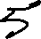












Slide 10

























Slide 11







Slide 12





























Slide 13












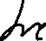





























Slide 14
















Slide 15






















Slide 16












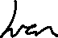
















Slide 17





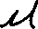




















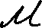


Slide 18



















































Slide 19






























Slide 20











Slide 21


















Slide 22
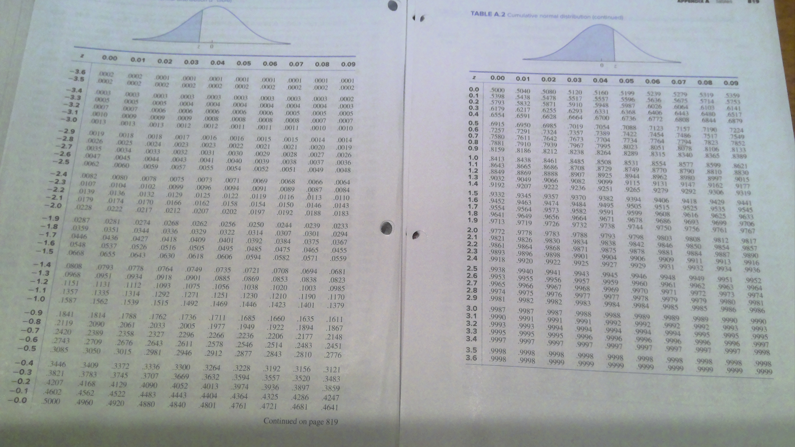

Slide 23

























Slide 24



















Slide 25




















